Slide 1
Feedback based News Recommendation Systems
Group No. 49
Samiksha Garg (MT21074)
Debnath Kundu (MT22026)
Shambhavi Pathak (MT22067)
Snehal Buldeo (MT22074)
Notes:
Good AfterNoon Everyone, Today, we will be presenting our survey paper on Word Embeddings and Language Models.
In this presentation, we will provide an overview of the development of some natural language processing techniques based on deep learning approaches based on probabilistic models.
We hope you find this presentation informative and engaging. Please feel free to ask questions.

Slide 2

Introduction
Introducing content diversification in news recommendations of a user to avoid over-personalisation of news feed.
source: spreadprivacy.com
Group 49 : Introducing Diversification in News Recommendation System
Notes:
Good evening
As part of our project we introduce diversification to the user’s news recommendation list post the their agreement. The motivation behind our topic is to avoid over-personalization of news feed. To make sure our news readers are not trapped in a bubble of their choices and topics.
As over-personalization of news feed can lead to spreading of rumours as too many content around a topic can involve content which are not factual and have been circulated for the sole purpose of influencing the mass.

Slide 3
What are we trying to avoid?
Filter Bubble: It corresponds to intellectual isolation caused by personalized searches or algorithms to selectively assume the information an individual wants to see
Echo Chamber: It refers to an information bubble around a user, where the user is only exposed to articles that reinforce their existing beliefs.
“A lot of times, people don’t know what they want until you show it to them” — Steve Jobs
Group 49 : Introducing Diversification in News Recommendation System
Notes:
A filter bubble or echo chamber refers to the way that algorithms on social media and search engines can tailor the information that users see based on their previous search history and engagement patterns. As a result, people may only be exposed to content that reinforces their existing beliefs and interests, rather than being exposed to a wide range of perspectives. Filter bubbles can lead to a distorted view of reality, as people may be unaware of important issues and events outside of their bubble.
- And the problem we are trying to address is that how can the news readers break out of their filter bubble.

Slide 4
Data Collection
Why an existing BBC Dataset didn't work?
Old : Less relevant news
Many links missing
Journalism/Writing styles have changed.
No stratified sampling!
“We shape our buildings dataset; thereafter, they shape us.” ~ Winston Churchill
inShorts API saved us!
curated recent news
equal distribution of categories
extracted similar features
got a chance to fix a bug also!
Notes:
For our project we have curated the dataset from the Inshorts API, the reason behind not opting for a standard dataset like BBC is that the news is less relevant for the current time, many source links were outdated and the writing style has changed over time. Whereas with the Inshorts dataset we curated, we have recent news following current writing style and were able to extract similar features as the BBC news dataset. We were also able to generate a uniform number of news under each topic
BBC: 2012-2017
inShorts :
used category specific API (mixed news)
got a chance to fix a bug also.

Slide 5
Data Cleaning & Pre-processing
Duplicate Removal
Topic Modelling : Latent Dirichlet Allocation (LDA)
extracted sub-categories for a category
Sentiment Analysis
Web Scraping
Extracted features on the entire news article text:
Subjectivity
Polarity / Stance (Polarisation)
Sentiment
Notes:
An article can be a part of multiple topics, kind of like in fuzzy clustering(soft clustering) in which each data point belongs to more than one cluster.
classified the documents into the discovered themes.
Diversification can be implemented through these aspects
user shown different opinions on a political event, or an entirely different political event.
Polarisation: usage of words like “very”, “extreme”
subjectivity: If the article is fact based, the subjectivity is 1 or 0 if its entirely opinion based.
sub-category: Kohli-Anushka sharma : Celebrity : Bollywood + Sports

Slide 6
Methodology
Initial similarity based recommendation using already existing columns
Tf-Idf : vector representation of articles
Cosine Similarity : for recommendation
E.g.: Category, Headline & Short Description
Diversification based on the extracted columns
- 0 <= Diversification Factor <= 1
- Sequential topic diversification [1] using Intra-List Diversity
metric
E.g.: LDA Topic modelling, Subjectivity, Polarity & Sentiment Analysis
(on scraped news text)
Notes:
content based rather than user modelling.
Intra-List Diversity: 1- avg. pairwise similarity

Slide 7
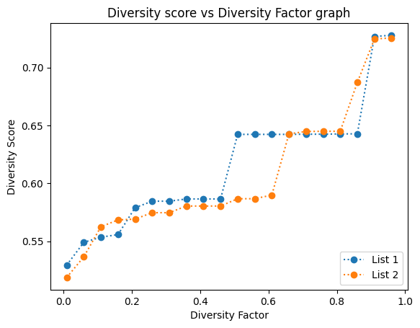
Evaluation Metrics & Results
Each point is a diversified list at a particular diversification factor.

Slide 8
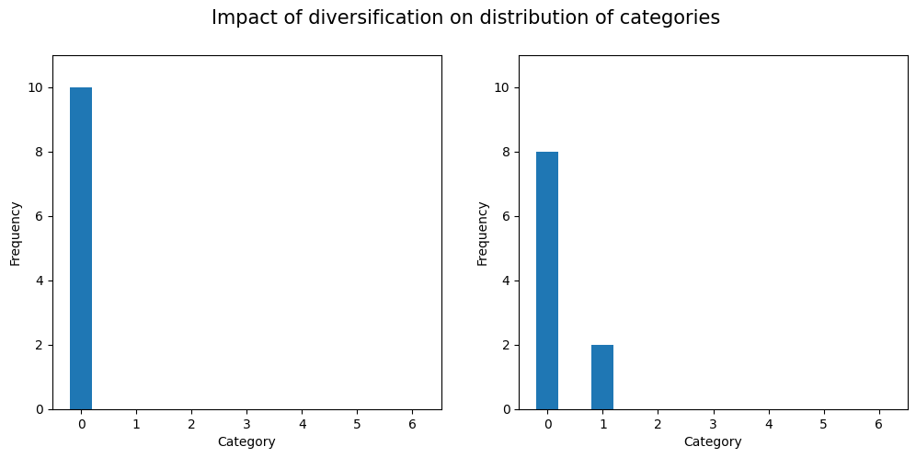
Evaluation Metrics & Results
The main category distribution has improved.

Slide 9
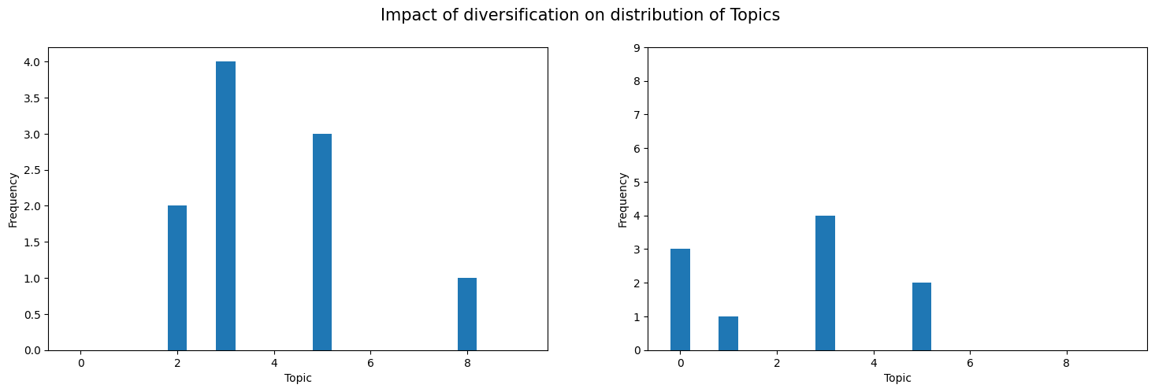
Evaluation Metrics & Results
The sub-category distribution has a huge enhancement.
User preference has been preserved to some extent!!

Slide 10
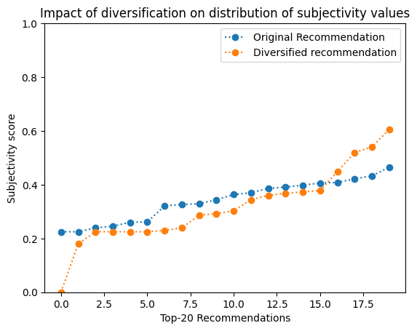
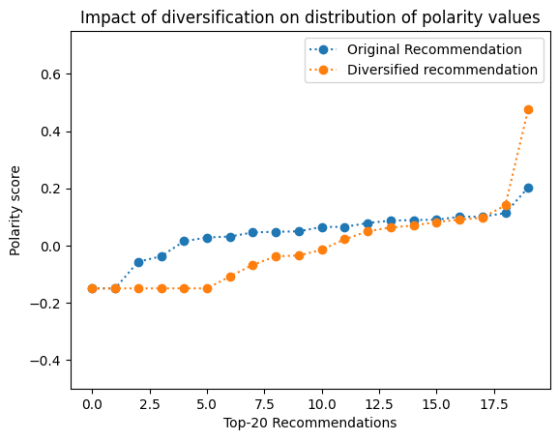
Evaluation Metrics & Results
SSS
Subjectivity & Polarity score comparison

Slide 11
Conclusion
Achieved diversification of recommended news articles based on features extracted from the article text.
Diversification threshold has a considerable impact on the diversity score of diversified lists.

Slide 12
Contribution
Debnath Kundu (MT22026) - Research, News article extraction(web scraping), Sentiment Analysis (polarity and subjectivity)
Shambhavi Pathak (MT22067) - Research, Dataset generation (using InShorts API), Report
Samiksha Garg (MT21074) - UI development, Integration, Deployment
Snehal Buldeo (MT22074) - Research, LDA (Topic extraction), Diversification of recommendations
Sakshi Sinha (MT22121) (till midsem) - Research, Literature Review

Slide 13
References
[1] C.-N. Ziegler, S. M. McNee, J. A. Konstan, and G. Lausen, “Improving recommendation lists through topic diversification,” in Proceedings of the 14th international conference on World Wide Web - WWW ’05, Chiba, Japan: ACM Press, 2005, p. 22. doi: 10.1145/1060745.1060754.
[2] S. Raza and C. Ding, “News recommender system: a review of recent progress, challenges, and opportunities,” Artif Intell Rev, vol. 55, no. 1, pp. 749–800, Jan. 2022, doi: 10.1007/s10462-021-10043-x.
[3] C. Yu, L. V. S. Lakshmanan, and S. Amer-Yahia, “Recommendation Diversification Using Explanations,” in 2009 IEEE 25th International Conference on Data Engineering, Shanghai, China: IEEE, Mar. 2009, pp. 1299–1302. doi: 10.1109/ICDE.2009.225.
[4] Kunaver M, Porl T (2017) Diversity in recommender systems a survey. Know-Based Syst 123:154–162
Group 49 : Introducing Diversification in News Recommendation System

Slide 14
Thank You!
Questions?
Group No. 49
Samiksha Garg (MT21074)
Debnath Kundu (MT22026)
Shambhavi Pathak (MT22067)
Snehal Buldeo (MT22074)

